Slide 1
Databases and Applications
Introduction
James Shen, Ph.D.
Department of Computer Science
California State University, Fullerton

Slide 2
Enterprise Web Application
Applications hosted on centralized servers within an enterprise
Users interact with the applications via browsers to accomplish certain business goals
  Online Shopping
  Online Teaching
  Insurance Policy Purchasing (/Claim Reporting)
  etc

Slide 3
Web Development Technologies
Static-content applications
  HTML, HTTP
Dynamic-content applications
  Common Gateway Interface (CGI)
  Server-side Scripting
Enterprise Application Frameworks
  J2EE, .NET, PHP Frameworks
Client-side dynamics of HTML
  CSS, jQuery, Ajax

Slide 4


Server-side Scripting Architecture
Linux/Windows
script file, params/HTTP request
Developers via Browser
HTTP Server
Other Servers
HTTP response
script file
Output page
WS server
Scripting Server
App. Files
Script File
Database Server
HTML with embedded scripting code

Slide 5
Server-Side Scripting Language
Provides basic language constructs to implement business logic
Provides mechanism to interact with HTTP servers
Provides mechanisms to
  Manipulate files
  Manipulate fata from SQL databases
  Interact with FTP, Mail servers
  Interact with 3rd party applications via Web Service
  Perform web-related tasks

Slide 6
Server-side Scripting Language
Personal Home Page (PHP)
Java Server Page (JSP)
Active Server Page (ASP)
ColdFusion Markup Language
Tcl
Python
etc

Slide 7
Introduction to PHP - History
In 1995, an independent software development contractor named Rasmus Lerdorf developed a Perl/CGI script to: 1) logging visitor information, and 2) displaying the count of visitors to the Web page.
They prompted e-mails inquiring about Lerdorf's scripts. Lerdorf thus began giving away his toolset, dubbed Personal Home Page (PHP).
In November 1997, PHP 2.0 was released with form interface.
By the June 1998 release of version 3.0, more than 50,000 users were using PHP to enhance their Web pages.
At the beginning of 1999, Netcraft (http://www.netcraft.com/) reported a conservative estimate of a user base surpassing 1,000,000, making PHP one of the most popular scripting languages in the world.

Slide 8
PHP Server Highlights
Language Features
  HPH engine is an interpreter
  Variable declaration & casting
  Weakly-typed variables
  MySQL integration
  Extensions etc
Interaction with HTTP servers
  Invoked by HTTP servers via CGI/SAPI
  HTTP servers sends data via Superglobals

Slide 9
PHP Server Highlights (Cont.)
PECL Extensions
  Filesystem extension (Manipulate files)
  MySQL, MySQLi (Manipulate MySQL databases)
  FTP extension (Interact with FTP servers)
  SOAP extension (Interact with 3rd party applications via Web Service)
  Perform web-related tasks
    Session extensions
    Non-Text MIME Output extensions
    Search Engines extensions
    Server Specific extensions

Slide 10

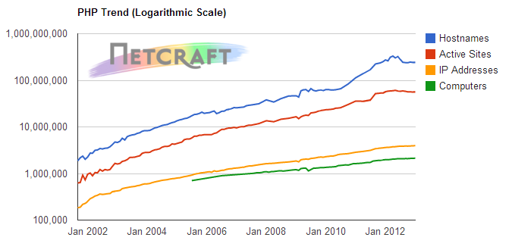
PHP Trend

Slide 11
PHP Strengths
Performance
Scalability
Database Integration
Extensibility
Cost
Portability
Open Source

